Slide 1
H2T Electronic Device Chatbot
Concept Video

Slide 2
Table of contents
01
04
02
03
Value Proposition
Values in design
Project name, value proposition and sanity check
Stakeholders and ethical implications
05
Tasks
Problem Overview
User, problem and solution
Simple, moderate, and complex use cases
06
Storyboard
Market Research
Competitors and Comparisons
Video storyboard

Slide 3
01
Value Proposition
Project name, value proposition and sanity check

Slide 4
H2T
“Highly Higher Tech”
Value Proposition
Combination of members’ names
We don't just bring you technology; we bring you higher, better technology.
We tend to highlight smarter choices and advanced tech for users’ perfect purchase.

Slide 5
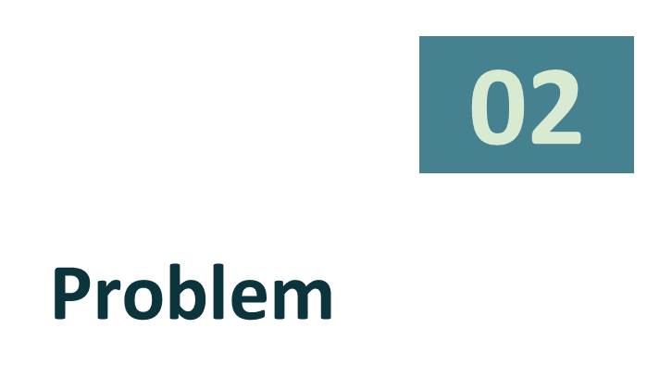
User, problem and solution

Slide 6
Target users
Students
Office Workers
Offer gadgets tailored to their fields of study: providing a powerful laptop for programming, a tablet for original design or tools for efficient research,…
They often need reliable and advanced tech devices to increase productivity and improve work efficiency—and they want to stay connected in their busy lives.
and more…

Slide 7
Problem
We are addressing the challenge of choosing the right electronic devices for your needs.
The overwhelming variety of options can be confusing; meanwhile features budgets and personal preferences must be balanced.
We objective to simplify this decision-making process by using a clever chatbot that gives personalized advice and makes technology shopping easy, informed and enjoyable.

Slide 8
Solution
We recognize that within our audience, there is a wide variety of preferences and levels of technological knowledge.
Some users want quick and simple suggestions, while others prefer in-depth advice tailored to specific needs.
Our chatbot aim to simplify electronics selection for all users, offering:
Personalized recommendations based on preferences, budget, and lifestyle.
Suggestions for work, gaming, studying, or entertainment.
Consultations for quick advice or detailed comparisons.
Community reviews and expert insights.
Wishlist and alerts for price drops or new arrivals.

Slide 9
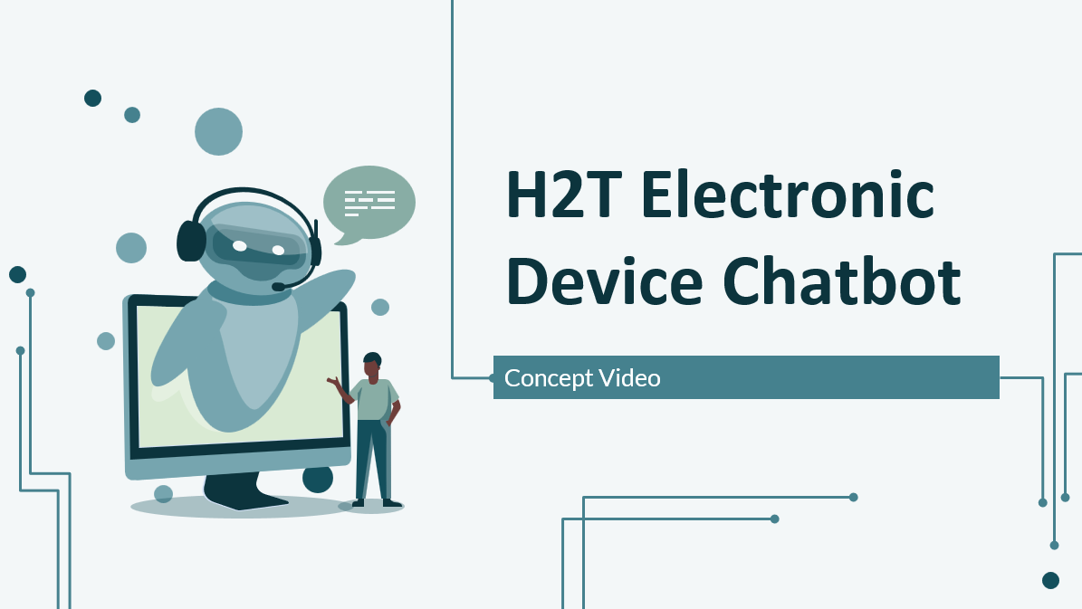
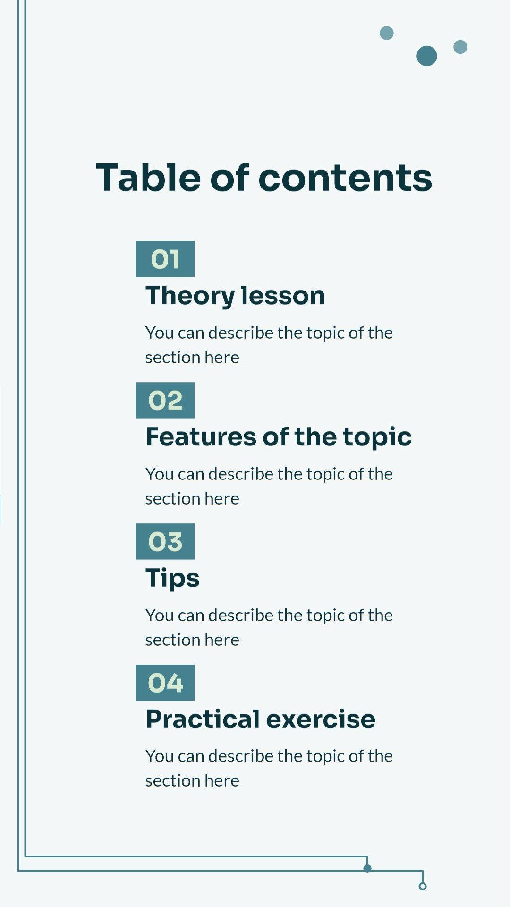
Market Research
03
Current competitors and how we compare

Slide 10

CellphoneS
What we can learn
The half lower part is clean by having prominent promotional banners
Intuitive filters for narrowing down product choices by brand, specs, and price
What doesn’t work
No chatbot, consultants are through Zalo, not directly from website
Some texts are too small, products’ layout is messy
Not personalize recommendations for users

Slide 11

Thegioididong
What we can learn
Products can be sorted by types, price, brand, performance,…
Harmonious theme colors, text fonts are easy to read
Save users’ carelist even if they don’t log in, showing these products’ price and exist status while navigating
What doesn’t work
No chatbot or online consultant at all
Save history but not personalize recommendations for users

Slide 12

FPTShop
What we can learn
Having responsive designs for many types of devices.
Personalizes user experiences based on browsing behavior and preferences
A visually appealing, with clear and sharp images, and banners that have a consistent color tone.
What doesn’t work
No chatbot, consultants are through Zalo, not directly from website
Large number of product categories might be overwhelming for users.

Slide 13
What we will take away
Responsive and user-friendly design:
Effective product presentation:
Adaptable layouts for various devices.
Personalizes user experience based on preferences and browsing behavior.
Clear, sharp visuals with consistent color themes and readable fonts.
Allows sorting products by multiple criteria (type, price, brand, etc.).
Intuitive filters to help narrow down choices.
Persistent carelist tracking products interest & updates even without login.

Slide 14
What we will enhance
Personalization & engagement:
Improve design and usability:
Integrate a chatbot for instant user support.
Chatbot sending updates of user products interest.
Organize product layouts more neatly to avoid a cluttered look.
Avoid overwhelming users with too many categories by simplifying navigation.

Slide 15
04
Values in design

Slide 16
Stakeholders
Direct
Indirect
Electronic companies
Schools
Students
E-commerce platforms
KOL/KOC in electronic fields
Sales
Ethical Implication
Sales can be fired and replaced by our websites.
Users can get the wrong answer and they will not believe in our web anymore.
Using our app too much can harm your eyes => using blue light to protect.

Slide 17
05
Tasks

Slide 18
Tasks
Simple
Moderate
Complex
Set products you may interest in default per day (banner)
Check prduct by categories
Check the product's detail information
Check the product's price
Add product into cart and buy it
Upload your requirement of your product
Sync the users 'activities to predict what product they want to buy
Use chatbox to find the product
Ask your friend to make sure the chat bot suggestion is good.

Slide 19
06
Storyboard
Bring the ideas to life

Slide 20
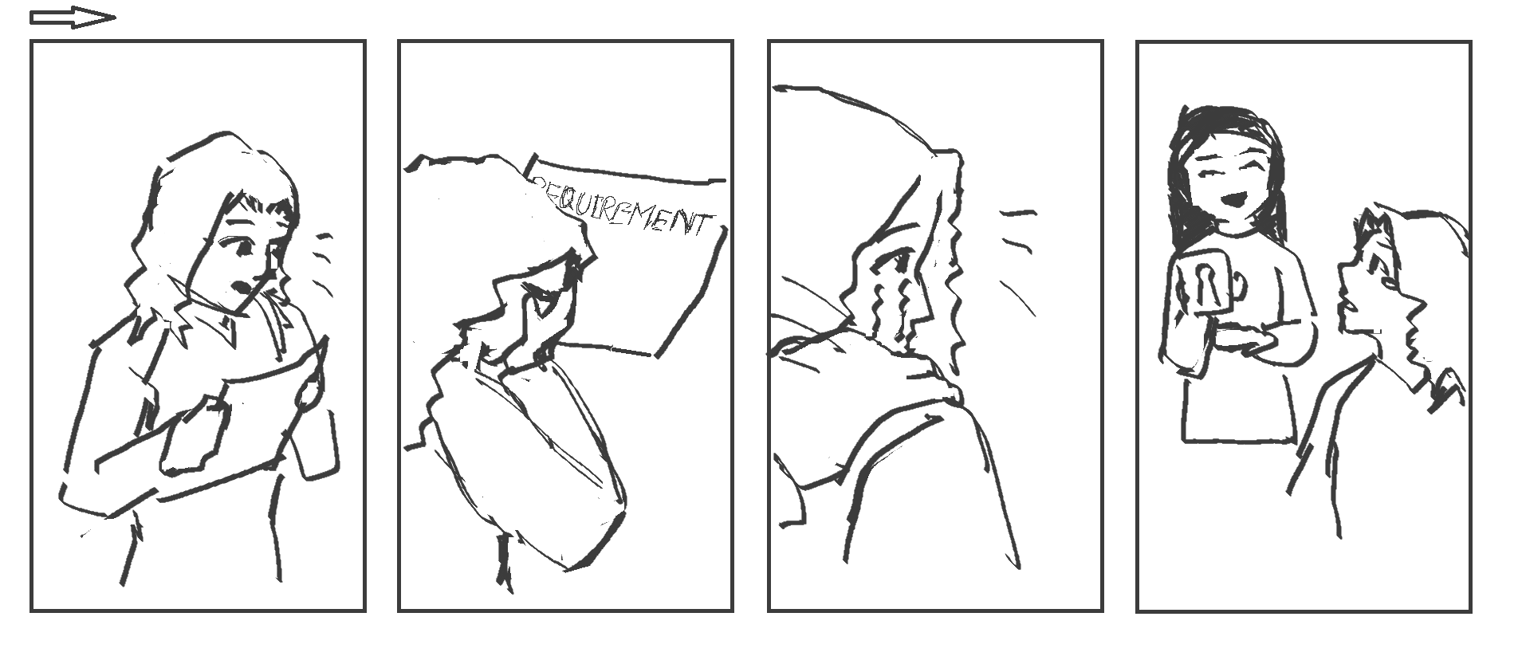
A girl who just got into ET-E16 receives the long list of necessary electrical equipments. She doesn't know what to buy
A classmate offers her a new e-commerce website comes with an AI chatbot which assists in recommendations

Slide 21
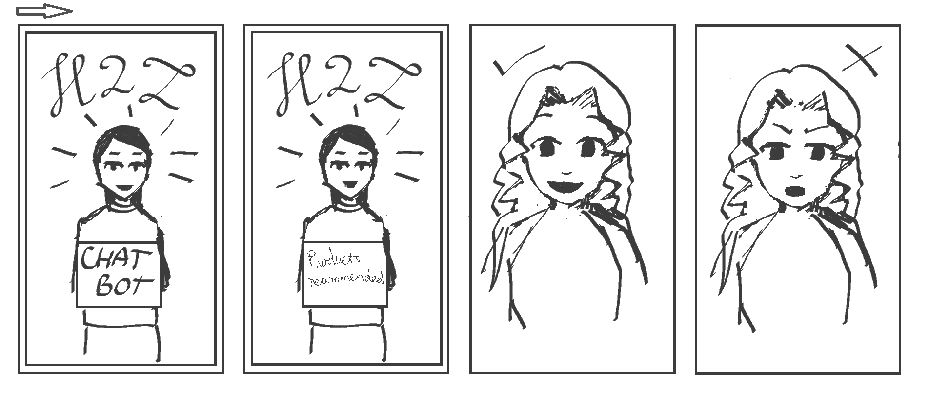
The chatbot gives recommendations base on the girl's requirements
The girl makes decisions depend on which product is given

Slide 22
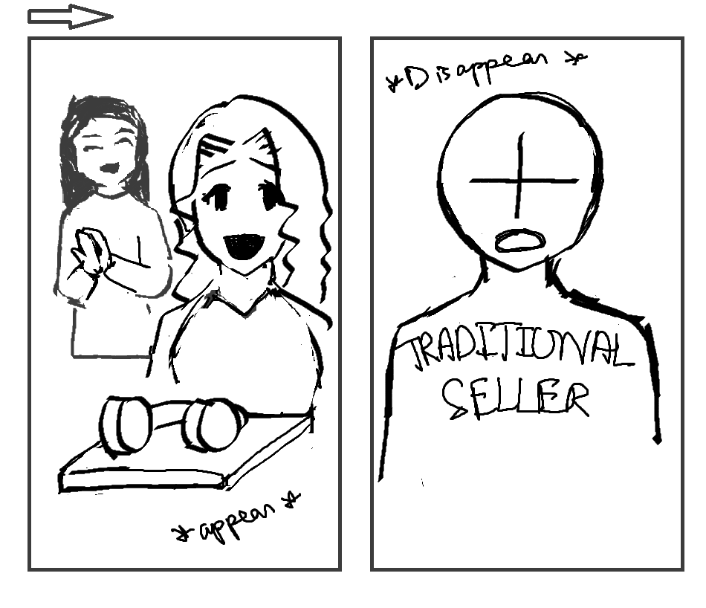
The chosen products appear before the girl
At the same time, traditional sellers disappear

Slide 23
Thanks!
Do you have any questions?
hang.ntt213570@sis.hust.edu.vn
huong.nt210423@sis.hust.edu.vn
trang.bh21085@sis.hust.edu.vn

Slide 24


